Slide 1
kathara lab
basic IPv4 configuration, ping, traceroute and arp
Version | 1.0
Author(s) | L. Ariemma, T. Caiazzi, G. Di Battista, M. Patrignani, M. Pizzonia, F. Ricci, M. Rimondini
E-mail | contact@kathara.org
Web | http://www.kathara.org/
Description | basic IPv4 configuration commands, usage of ping and traceroute, arp behaviour

Slide 2
copyright notice
All the pages/slides in this presentation, including but not limited to, images, photos, animations, videos, sounds, music, and text (hereby referred to as “material”) are protected by copyright.
This material, with the exception of some multimedia elements licensed by other organizations, is property of the authors and/or organizations appearing in the first slide.
This material, or its parts, can be reproduced and used for didactical purposes within universities and schools, provided that this happens for non-profit purposes.
Information contained in this material cannot be used within network design projects or other products of any kind.
Any other use is prohibited, unless explicitly authorized by the authors on the basis of an explicit agreement.
The authors assume no responsibility about this material and provide this material “as is”, with no implicit or explicit warranty about the correctness and completeness of its contents, which may be subject to changes.
This copyright notice must always be redistributed together with the material, or its portions.

Slide 3
content of the lab
© Computer Networks Research Group Roma Tre
there are two routers, called r1 and r2, and three hosts, called pc1, pc2, and pc3
they are connected via three LANs
we force their MAC addresses to be easily readable
we will learn how to:
assign an IPv4 address and a netmask to the interface of a host
assign a default gateway to the interface of a host
set the routing table of a router
we will use the ping and traceroute commands
we will observe the behavior of ARP

Slide 4
lab configuration

Slide 5
network topology – high level view
pc2
pc3
pc1
r1
r2

Slide 6
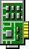



network topology – MAC addresses
pc1
pc2
pc3
0:1
eth0
eth0
0:2
0:3
eth0
A
C
0:a1
eth0
B
eth0
0:c1
r1
r2
eth1
eth1
0:b1
0:b2

Slide 7
network topology – IPv4 address plan
pc1
pc2
pc3
eth0
.5
.7
eth0
eth0
.3
A
C
195.11.14.0/24
200.1.1.0/24
.1
eth0
B
eth0
.1
r1
r2
eth1
100.0.0.8/30
eth1
.9
.10

Slide 8
network topology – complete overview
pc1
pc2
pc3
0:1
eth0
.5
.7
eth0
0:2
0:3
eth0
.3
A
C
195.11.14.0/24
200.1.1.0/24
0:a1
.1
eth0
B
eth0
.1
0:c1
r1
r2
eth1
100.0.0.8/30
eth1
0:b1
.9
.10
0:b2

Slide 9
a quick look at the lab
lab.conf
lab.conf
r1[0]="A/00:00:00:00:00:a1"
r1[1]="B/00:00:00:00:00:b1"
r1[image]="kathara/base"
r1[ipv6]="false"
r2[0]="C/00:00:00:00:00:c1"
r2[1]="B/00:00:00:00:00:b2"
r2[image]="kathara/base"
r2[ipv6]="false"
pc1[0]="A/00:00:00:00:00:01"
pc1[image]="kathara/base"
pc1[ipv6]="false"
pc2[0]="C/00:00:00:00:00:02"
pc2[image]="kathara/base"
pc2[ipv6]="false"
pc3[0]="C/00:00:00:00:00:03"
pc3[image]="kathara/base"
pc3[ipv6]="false"
wireshark[bridged]=true
wireshark[port]="3000:3000"
wireshark[image]="lscr.io/linuxserver/wireshark"
wireshark[num_terms]=0

Slide 10
a quick look at the lab
pc1.startup
ip address add 195.11.14.5/24 dev eth0
ip route add default via 195.11.14.1
pc2.startup
ip address add 200.1.1.7/24 dev eth0
ip route add default via 200.1.1.1 dev eth0
pc3.startup
ip address add 200.1.1.3/24 dev eth0
ip route add default via 200.1.1.1 dev eth0

Slide 11
a quick look at the lab
an IPv4 address is assigned to the eth0 interfaces of hosts
pc1.startup
ip address add 195.11.14.5/24 dev eth0
ip route add default via 195.11.14.1
pc2.startup
ip address add 200.1.1.7/24 dev eth0
ip route add default via 200.1.1.1 dev eth0
pc3.startup
ip address add 200.1.1.3/24 dev eth0
ip route add default via 200.1.1.1 dev eth0

Slide 12
a quick look at the lab
an IPv4 address is assigned to the eth0 interfaces of hosts
pc1.startup
ip address add 195.11.14.5/24 dev eth0
ip route add default via 195.11.14.1
a default gateway is set
for all hosts
pc2.startup
ip address add 200.1.1.7/24 dev eth0
ip route add default via 200.1.1.1 dev eth0
pc3.startup
ip address add 200.1.1.3/24 dev eth0
ip route add default via 200.1.1.1 dev eth0

Slide 13
a quick look at the lab
r1.startup
ip address add 195.11.14.1/24 dev eth0
ip address add 100.0.0.9/30 dev eth1
ip route add 200.1.1.0/24 via 100.0.0.10 dev eth1

Slide 14
a quick look at the lab
an IPv4 address is assigned to interfaces eth0 and eth1 of router r1
r1.startup
ip address add 195.11.14.1/24 dev eth0
ip address add 100.0.0.9/30 dev eth1
ip route add 200.1.1.0/24 via 100.0.0.10 dev eth1
consequently, the corresponding LANs are considered directly connected

Slide 15
a quick look at the lab
an IPv4 address is assigned to interfaces eth0 and eth1 of router r1
r1.startup
ip address add 195.11.14.1/24 dev eth0
ip address add 100.0.0.9/30 dev eth1
ip route add 200.1.1.0/24 via 100.0.0.10 dev eth1
consequently, the corresponding LANs are considered directly connected
a row is added to the routing table on how to reach a LAN that is not directly connected

Slide 16
a quick look at the lab
an IPv4 address is assigned to interfaces eth0 and eth1 of router r1
r1.startup
ip address add 195.11.14.1/24 dev eth0
ip address add 100.0.0.9/30 dev eth1
ip route add 200.1.1.0/24 via 100.0.0.10 dev eth1
consequently, the corresponding LANs are considered directly connected
a row is added to the routing table on how to reach a LAN that is not directly connected
similar configuration for router r2

Slide 17
start the lab
start the lab
user@localhost:~$ cd kathara-lab_basic-ipv4
user@localhost:~/kathara-lab_basic-ipv4$ kathara lstart

Slide 18
useful commands

Slide 19
check the IPv4 addresses
on pc1, pc2, pc3, r1, and r2
perform the ip address command, to check the IPv4 addresses assigned to the interfaces
look at eth and loopback interfaces
loopback interface
127.0.0.1/8
pc1
root@pc1:/# ip address
1: lo: <LOOPBACK,UP,LOWER_UP> mtu 65536 qdisc noqueue state UNKNOWN group default qlen 1000
link/loopback 00:00:00:00:00:00 brd 00:00:00:00:00:00
inet 127.0.0.1/8 scope host lo
valid_lft forever preferred_lft forever
7: eth0: <BROADCAST,MULTICAST,UP,LOWER_UP> mtu 1500 qdisc fq_codel state UP group default qlen 1000
link/ether 00:00:00:00:00:01 brd ff:ff:ff:ff:ff:ff
inet 195.11.14.5/24 scope global eth0
valid_lft forever preferred_lft forever
eth0
195.11.14.5/24

Slide 20
check the default route
on pc1, pc2, and pc3
perform the routel command, to check the presence of a default route
pc1
default route by r1
root@pc1:/# routel
Dst Gateway Prefsrc Protocol Scope Dev Table
default 195.11.14.1 eth0
195.11.14.0/24 195.11.14.5 kernel link eth0
127.0.0.0/8 127.0.0.1 kernel host lo local
127.0.0.1 127.0.0.1 kernel host lo local
127.255.255.255 127.0.0.1 kernel link lo local
195.11.14.5 195.11.14.5 kernel host eth0 local
195.11.14.255 195.11.14.5 kernel link eth0 local
loopback prefix
useful information: for each d.c. network, my address and broadcast

Slide 21
check the router routing tables
on r1, and r2
perform the routel command, to check the routing table
Lan B
r1
root@r1:/# routel
Dst Gateway Prefsrc Protocol Scope Dev Table
100.0.0.8/30 100.0.0.9 kernel link eth1
195.11.14.0/24 195.11.14.1 kernel link eth0
200.1.1.0/24 100.0.0.10 eth1
100.0.0.9 100.0.0.9 kernel host eth1 local
100.0.0.11 100.0.0.9 kernel link eth1 local
127.0.0.0/8 127.0.0.1 kernel host lo local
127.0.0.1 127.0.0.1 kernel host lo local
127.255.255.255 127.0.0.1 kernel link lo local
195.11.14.1 195.11.14.1 kernel host eth0 local
195.11.14.255 195.11.14.1 kernel link eth0 local
Lan A
Lan C
useful information: for each d.c. network, my address and broadcast
r2

Slide 22
sniff the traffic
connect the wireshark device to collision domain C
open any browser on the host machine
on localhost:3000
sniff eth1
user@localhost:~/kathara-lab_basic-ipv4$ kathara lconfig -n wireshark --add C

Slide 23
ping from pc3 to pc2 and related arp behavior

Slide 24
on pc3
inspect the ARP cache
execute a ping command towards pc2
inspect again the ARP cache
give a look at the packets captured by Wireshark

Slide 25
inspecting the arp cache of pc3
ARP(8) Linux System Administrator's Manual
NAME
arp - manipulate the system ARP cache
SYNOPSIS
arp [-vn] [-H type] [-i if] [-ae] [hostname]
arp [-v] [-i if] -d hostname [pub]
arp [-v] [-H type] [-i if] -s hostname hw_addr [temp]
arp [-v] [-H type] [-i if] -s hostname hw_addr [netmask nm] pub
arp [-v] [-H type] [-i if] -Ds hostname ifname [netmask nm] pub
arp [-vnD] [-H type] [-i if] -f [filename]
DESCRIPTION
Arp manipulates or displays the kernel's IPv4 network neighbour cache. It can add entries to the table, delete one or display the currennt content.
ARP stands for Address Resolution Protocol, which is used to find the media access control address of a network neighbour for a given IPv4 Address
.......

Slide 26
inspecting the arp cache
arp is the command to inspect the arp cache
the –n parameter tells arp to not resolve the IP addresses with DNS names
root@pc3:/# arp -n
Address HWtype HWaddress Flags Mask Iface
200.1.1.7 ether 00:00:00:00:00:02 C eth0

Slide 27
inspecting the arp cache
the arp cache is initially empty
sending packets to 200.1.1.7 requires address resolution
pc3
root@pc3:/# arp -n
root@pc3:/# ping 200.1.1.7
PING 200.1.1.7 (200.1.1.7) 56(84) bytes of data.
64 bytes from 200.1.1.7: icmp_seq=1 ttl=64 time=1.93 ms
64 bytes from 200.1.1.7: icmp_seq=2 ttl=64 time=0.638 ms
--- 200.1.1.7 ping statistics ---
2 packets transmitted, 2 received, 0% packet loss, time 1001ms
rtt min/avg/max/mdev = 0.638/1.283/1.929/0.645 ms
root@pc3:/# arp -n
Address HWtype HWaddress Flags Mask Iface
200.1.1.7 ether 00:00:00:00:00:02 C eth0
address resolution results are stored in the arp cache

Slide 28
inspecting the arp cache
traffic within the same network does not traverse routers
pc1
pc2
pc3
.7
eth0
eth0
.3
C
200.1.1.0/24
eth0
.1
r1
r2

Slide 29
inspecting the arp cache
communications are usually bi-directional
the receiver of the arp request learns the mac address of the other party, to avoid a new arp in opposite direction (standard behavior, see rfc 826)
pc2
root@pc2:/# arp -n
Address HWtype HWaddress Flags Mask Iface
200.1.1.3 ether 00:00:00:00:00:03 C eth0

Slide 30
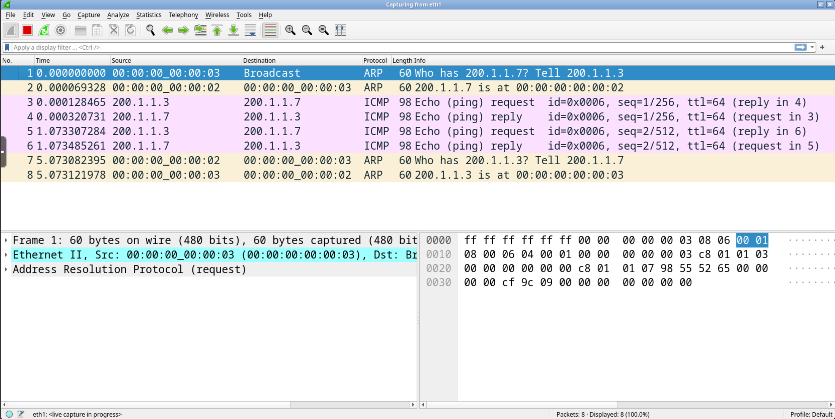
wireshark

Slide 31
wireshark
arp request

Slide 32
wireshark
arp request
arp reply

Slide 33
wireshark
arp request
arp reply
At the end of the ping a unicast arp request/reply dialogue takes place

Slide 34
ping from pc2 to pc1 and related arp behavior

Slide 35
sniff the traffic
connect the wireshark device to collision domain B
open any browser on the host machine
on localhost:3000
sniff eth2
user@localhost:~/kathara-lab_basic-ipv4$ kathara lconfig -n wireshark --add B

Slide 36
on pc2
execute a ping command towards pc1
pc2
root@pc2:/# ping 195.11.14.5
PING 195.11.14.5 (195.11.14.5) 56(84) bytes of data.
64 bytes from 195.11.14.5: icmp_seq=1 ttl=62 time=5.86 ms
64 bytes from 195.11.14.5: icmp_seq=2 ttl=62 time=1.69 ms
--- 195.11.14.5 ping statistics ---
2 packets transmitted, 2 received, 0% packet loss, time 1002ms
rtt min/avg/max/mdev = 1.688/3.771/5.855/2.083 ms

Slide 37
inspecting the arp cache (non local traffic)
pc1
pc2
pc3
eth0
.5
.7
eth0
eth0
.3
A
C
195.11.14.0/24
200.1.1.0/24
.1
eth0
B
eth0
.1
r1
r2
eth1
100.0.0.8/30
eth1
.9
.10

Slide 38
inspecting the arp cache (non local traffic)
when ip traffic is addressed outside the local network, the sender needs the mac address of the router
arp requests can get replies only within the local network
pc2
root@pc2:/# arp -n
Address HWtype HWaddress Flags Mask Iface
200.1.1.1 ether 00:00:00:00:00:c1 C eth0
200.1.1.3 ether 00:00:00:00:00:03 C eth0
root@pc2:/#
mac address of eth0 on r2

Slide 39
inspecting the arp cache (non local traffic)
what about routers?
routers perform arp too (hence have arp caches) anytime they have to send ip packets on an ethernet lan
r1
root@r1:/# arp -n
Address HWtype HWaddress Flags Mask Iface
195.11.14.5 ether 00:00:00:00:00:01 C eth0
100.0.0.10 ether 00:00:00:00:00:b2 C eth1
pc1
r2 (eth1)
r1 (eth1)
r2
root@r2:/# arp -n
Address HWtype HWaddress Flags Mask Iface
100.0.0.9 ether 00:00:00:00:00:b1 C eth1
200.1.1.7 ether 00:00:00:00:00:02 C eth0
pc2

Slide 40
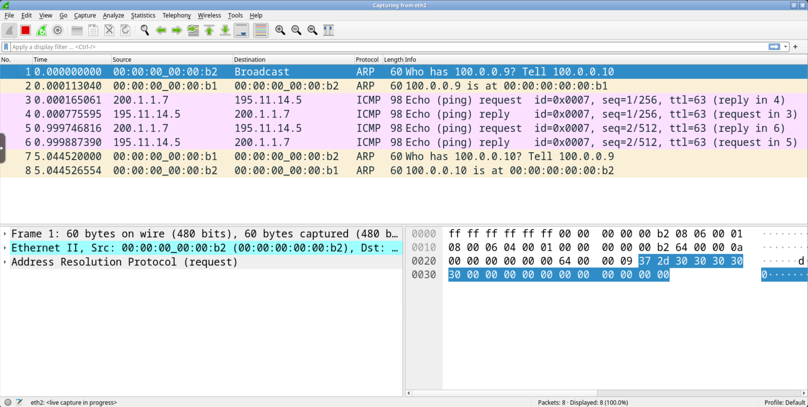
wireshark
which is the mac address of r1

Slide 41
understanding the whole picture
A
B
C
pc1
r1
r2
pc2
arp req
arp reply
icmp echo req
arp req
time
arp reply
icmp echo req
arp req
arp reply
icmp echo req
icmp echo reply
icmp echo reply
icmp echo reply

Slide 42
traceroute from pc2 to pc1 and related arp behavior

Slide 43
sniff the traffic
the wireshark host is already connected to collision domain C
open any browser on the host machine
on localhost:3000
sniff eth1

Slide 44
on pc2
execute a traceroute command towards pc1
Minimal time (sec. if ≤10, ms if >10) interval between probes (default 0)
eth0 of r2
pc2
root@pc2:/# traceroute 195.11.14.5 -z 1
traceroute to 195.11.14.5 (195.11.14.5), 30 hops max, 60 byte packets
1 200.1.1.1 (200.1.1.1) 0.882 ms 0.662 ms 0.456 ms
2 100.0.0.9 (100.0.0.9) 0.903 ms 0.877 ms 1.218 ms
3 195.11.14.5 (195.11.14.5) 0.987 ms 1.354 ms 1.015 ms
root@pc2:/#
eth1 of r1
eth0 of pc1

Slide 45
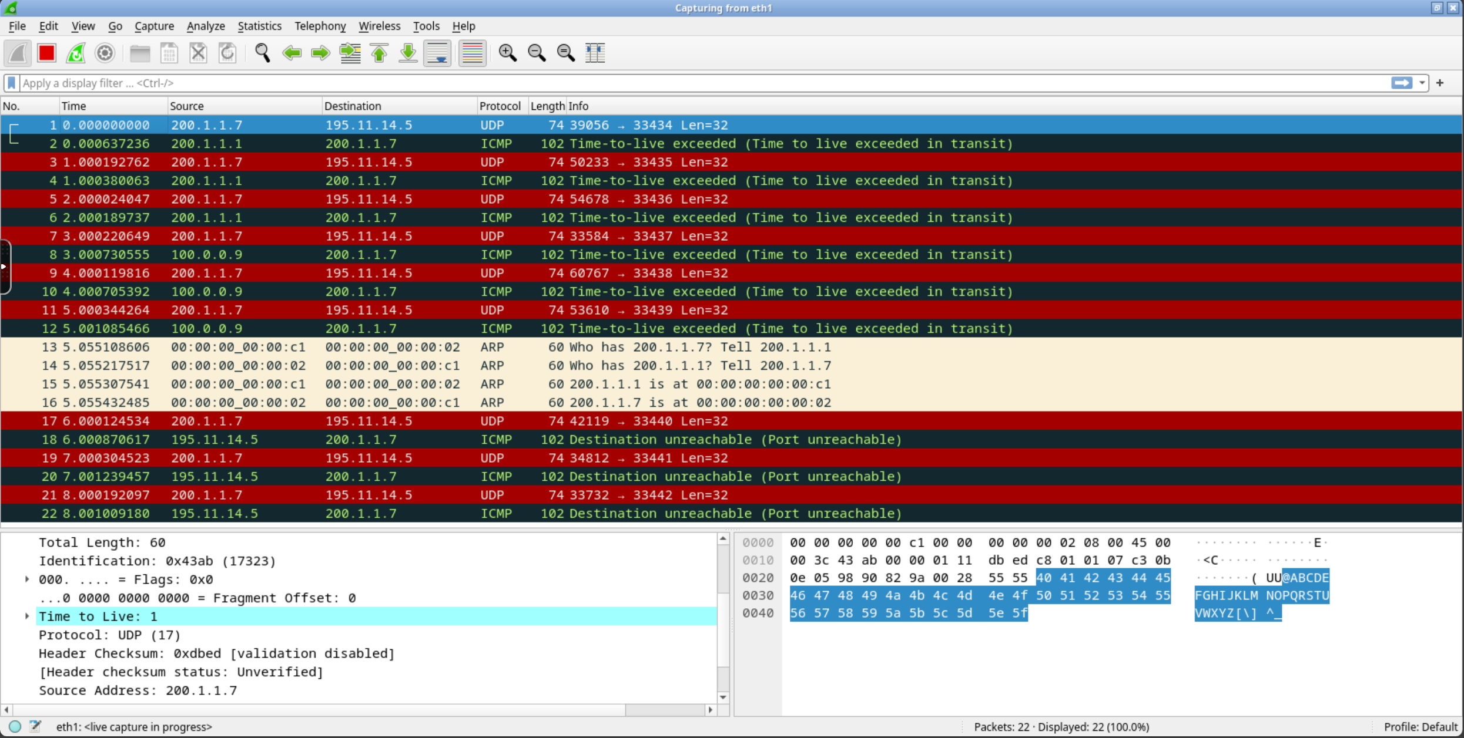
wireshark
udp packet and corresponding ICMP Time-to-live exceeded
Time to live: 1

Slide 46
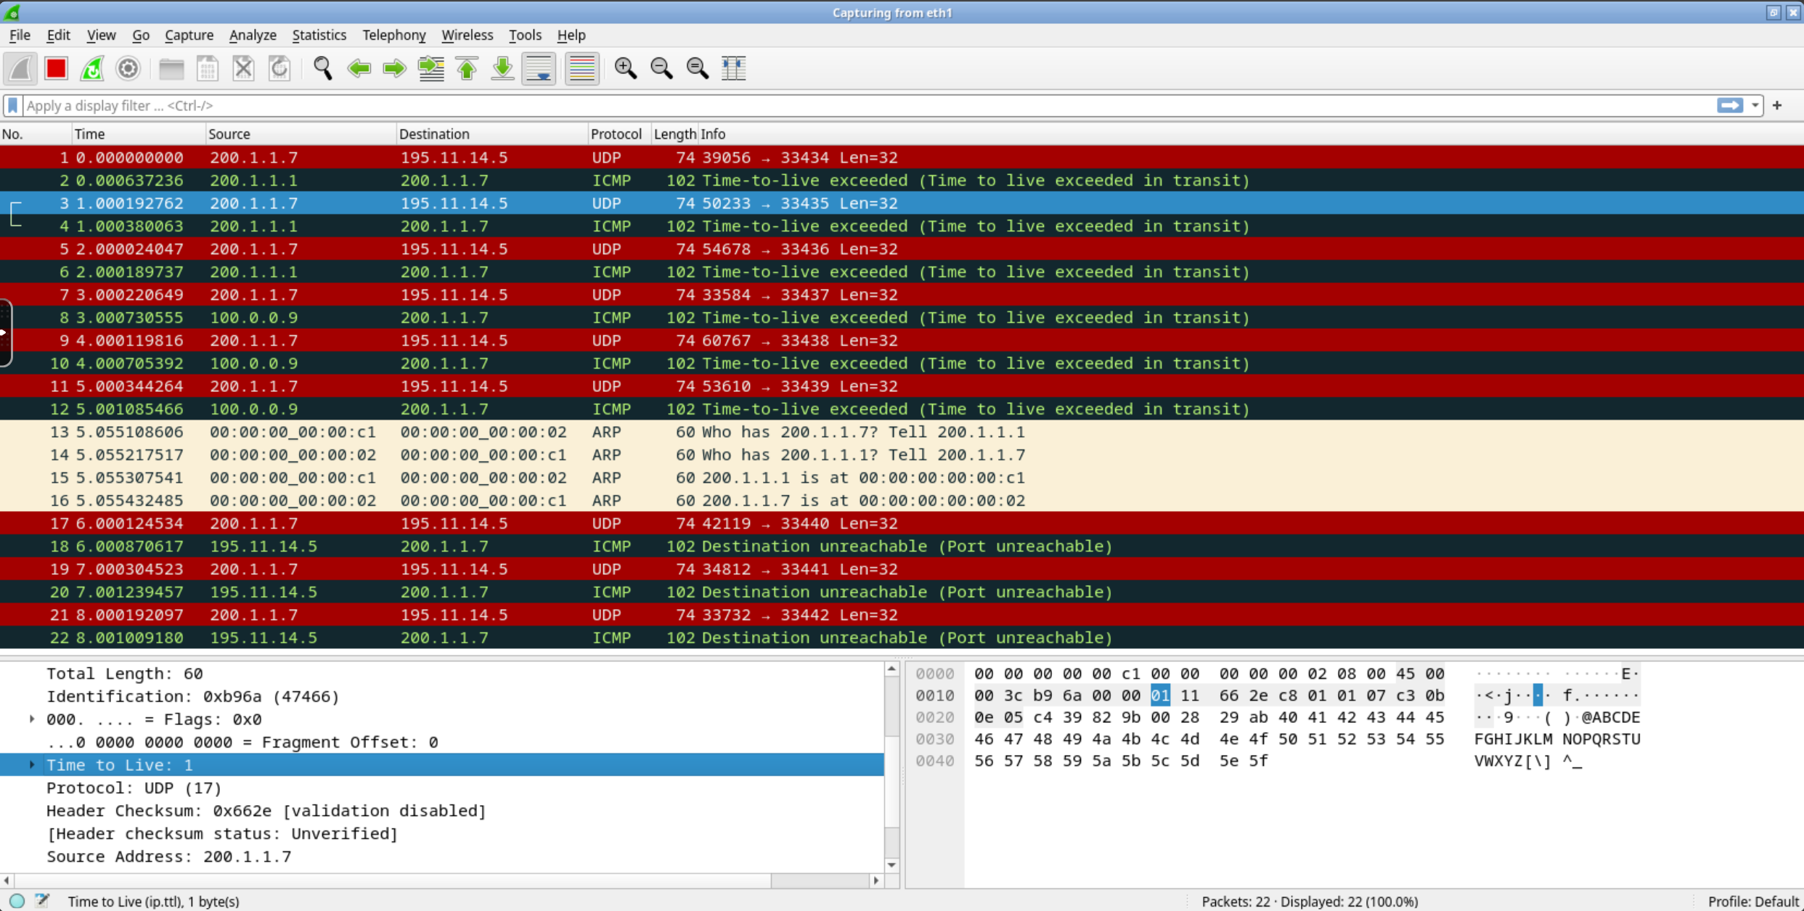
wireshark
udp packet and corresponding ICMP Time-to-live exceeded
3 probes for each ttl

Slide 47
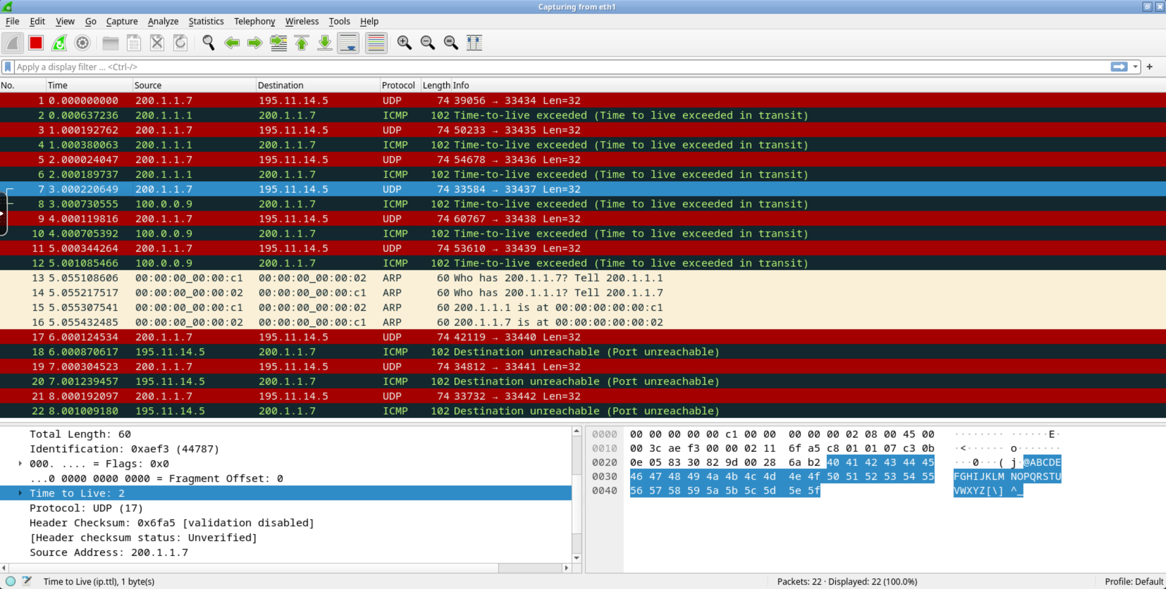
wireshark
udp packet and corresponding ICMP Time-to-live exceeded
Time to live: 2

Slide 48
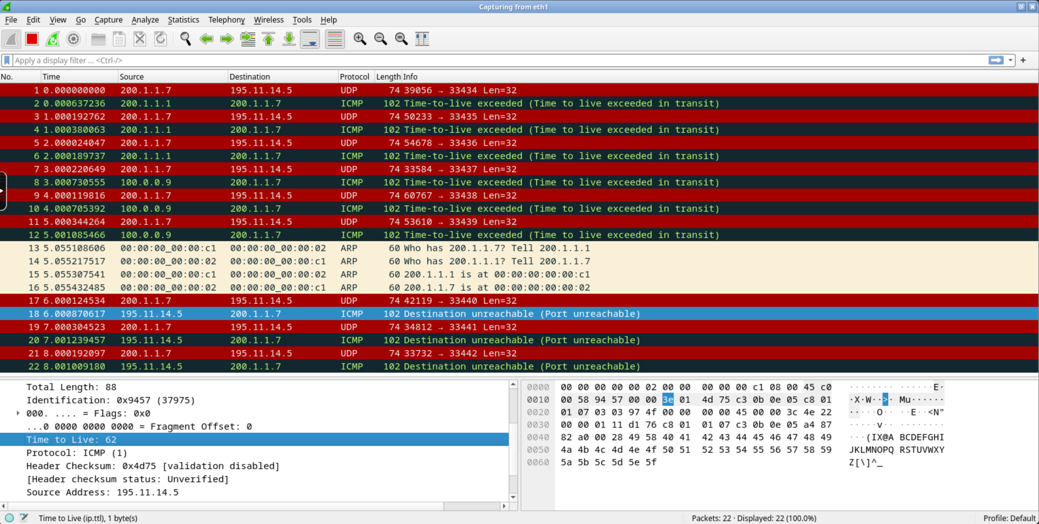
wireshark
destination reached!

Slide 49
wireshark
arp unicast queries are issued during the dialogue

Slide 50
proposed exercises
check the different error messages obtained by trying to ping an unreachable destination in the case of
local destination
non-local destination
which packets are exchanged in the local collision domain in the two cases?

